Slide 1

6th Grade Math
Unit 2, Lesson 4 Rewriting Sums Using the Distributive Property Volume 1, pg. 63

Slide 2


Benchmark
MA.6.NSO.3.2
Rewrite the sum of two composite whole numbers having a common factor, as a common factor multiplied by the sum of two whole numbers.
volume 1, pg. 63

Slide 3
Integrated Mathematical Thinking and Reasoning Standards
MA.K12.MTR.4.1 Engage in discussions that reflect on the mathematical thinking of self and others.
MA.K12.MTR.5.1 Use patterns and structure to help understand and connect mathematical concepts.
volume 1, pg. 63

Slide 4

Learning Target
I can rewrite the sum of two composite numbers with a common factor using the distributive property.
volume 1, pg. 63

Slide 5

Warm-Up
volume 1, pg. 63

Slide 6
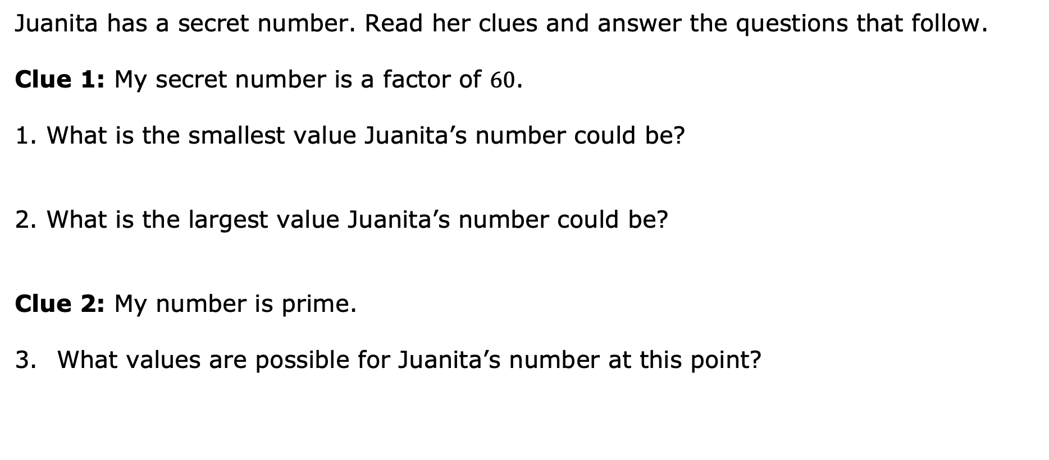
2.4.1 Warm-Up: Secret Number
Juanita has a secret number. Read her clues and answer the questions that follow.
Clue 1: My secret number is a factor of $60$.
What is the smallest value Juanita’s number could be?
What is the largest value Juanita’s number could be?
Clue 2: My number is prime.
What values are possible for Juanita’s number at this point?
volume 1, pg. 63

Slide 7
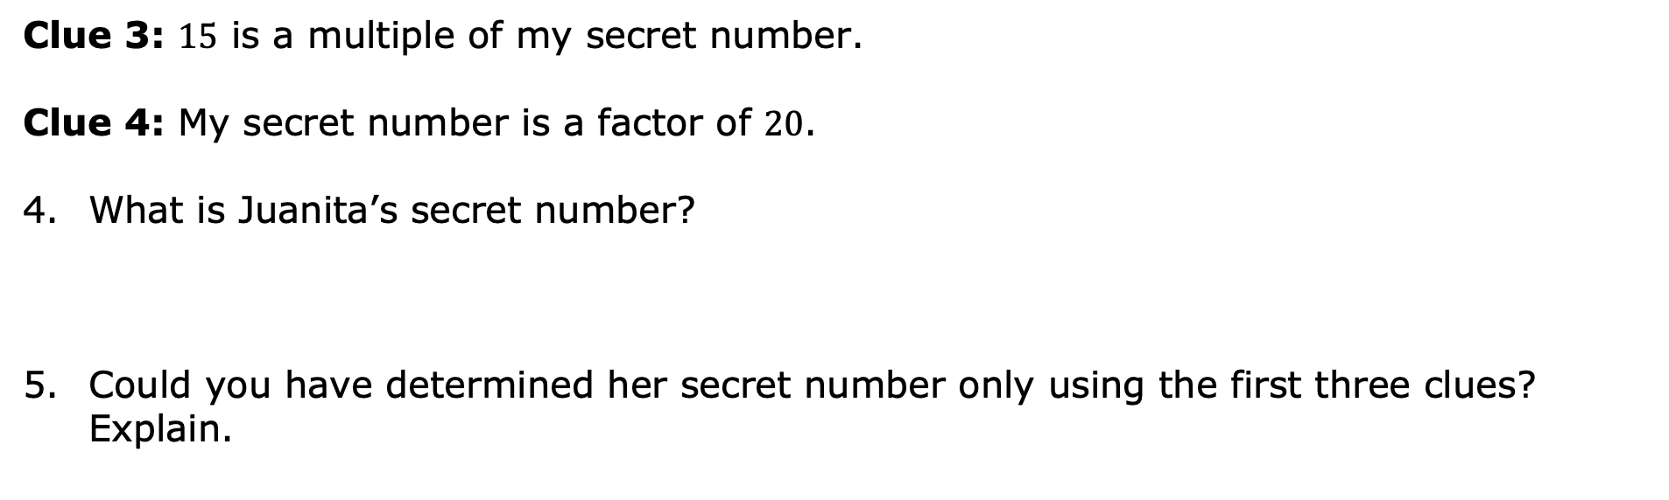
Clue 3: $15$ is a multiple of my secret number.
Clue 4: My secret number is a factor of $20$.
What is Juanita’s secret number?
Could you have determined her secret number only using the first three clues? Explain.
volume 1, pg. 63

Slide 8

Collaboration
volume 1, pg. 64

Slide 9

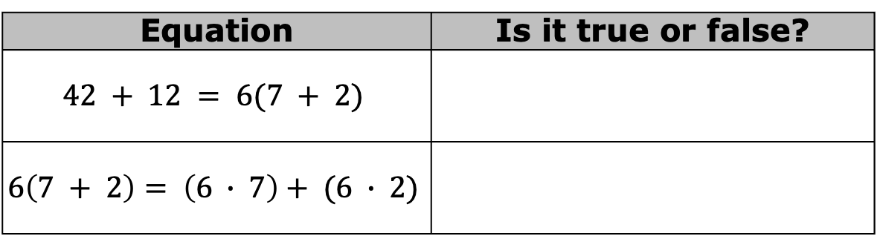

2.4.2 Collaboration: Equivalent Numeric Expressions
In each equation, two numeric expressions are set equal to each other.
With your partner, discuss whether each equation is true or false and complete the table.
How is $6$ related to $42$ and $12$?
Equation | Is it true or false?
$$42 + 12 = 6(7 + 2)$$
$$6\left(7 + 2\right)= \left(6 ∙ 7\right)+ (6 ∙ 2)$$
volume 1, pg. 64

Slide 10
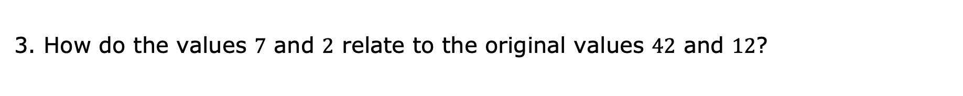
How do the values $7$ and $2$ relate to the original values $42$ and $12$?
volume 1, pg. 64

Slide 11

Guided Instruction
volume 1, pg. 64

Slide 12

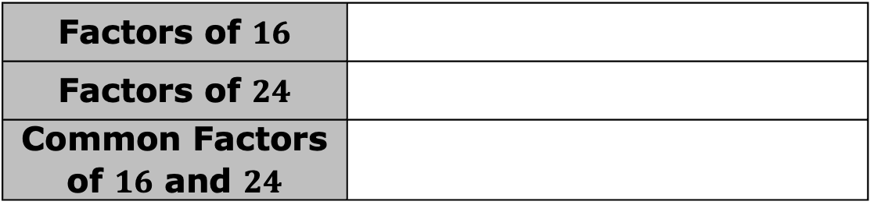
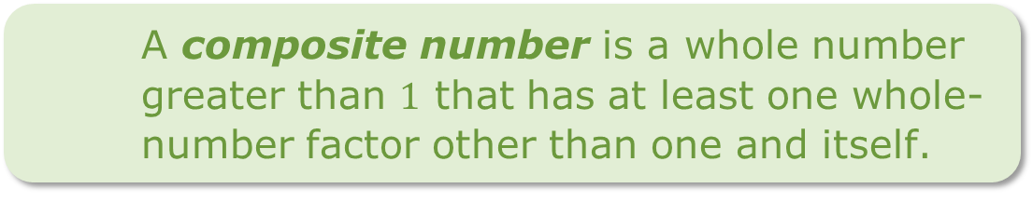

2.4.3 Guided Instruction: Rewriting Sums Using Distributive Property
Sums of composite whole numbers can be rewritten using the distributive property and a common factor of the numbers.
What are the common factors of $16$ and $24$?
A composite number is a whole number greater than $1$ that has at least one whole-number factor other than one and itself.
Factors of $16$
Factors of $24$
Common Factors of $16$ and $24$
volume 1, pg. 64

Slide 13
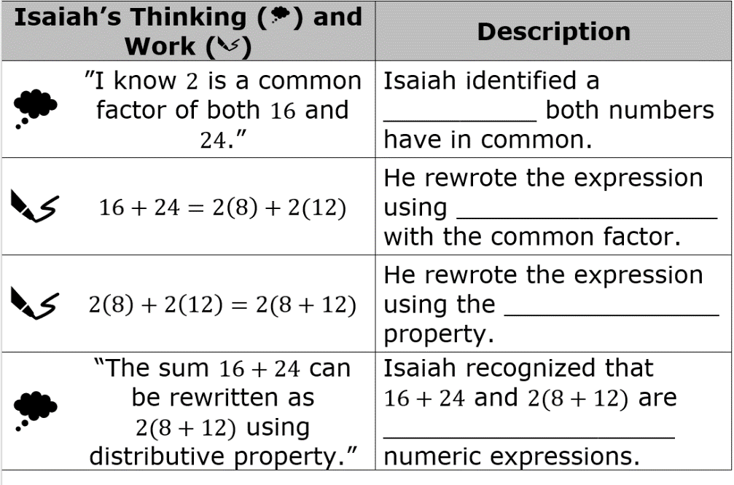
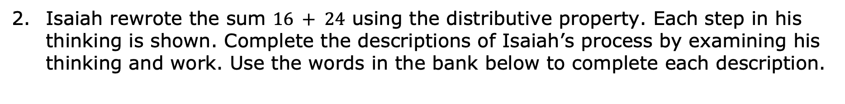
Isaiah rewrote the sum $16 + 24$ using the distributive property. Each step in his thinking is shown. Complete the descriptions of Isaiah’s process by examining his thinking and work. Use the words in the bank below to complete each description.
distributive equivalent factor multiplication
volume 1, pg. 65

Slide 14
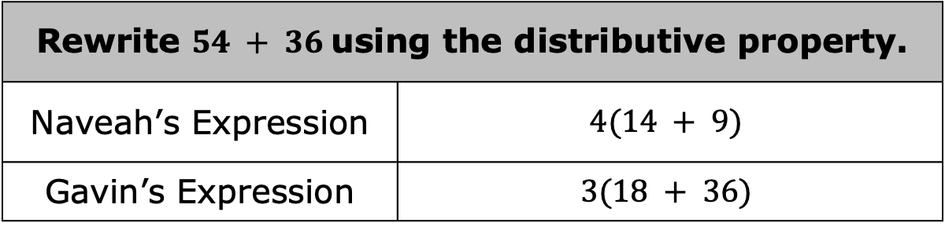
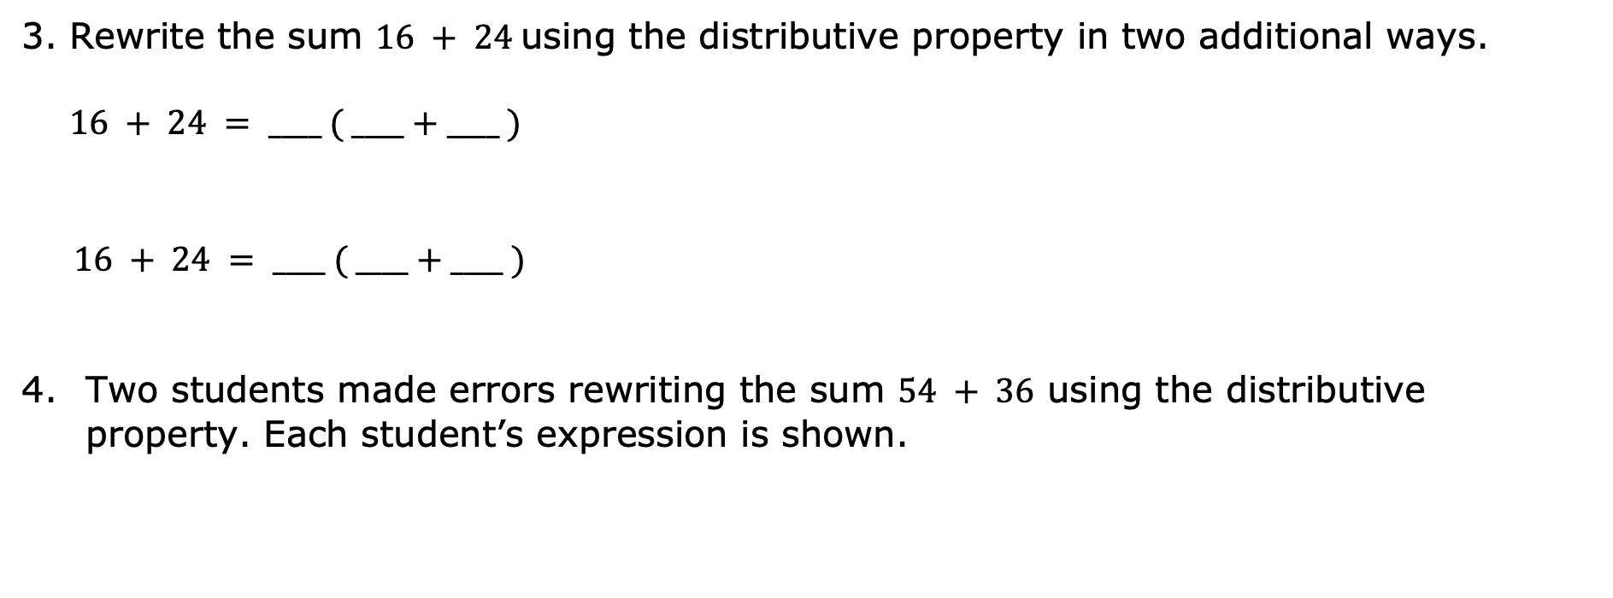
Rewrite the sum $16 + 24$ using the distributive property in two additional ways.
$$16 + 24 = ____ ( ____+____ )$$
$16 + 24 = ____ ( ____+____ )$
Two students made errors rewriting the sum $54 + 36$ using the distributive property. Each student’s expression is shown.
Rewrite $54 + 36$ using the distributive property.
Naveah’s Expression | $$4(14 + 9)$$
Gavin’s Expression | $$3(18 + 36)$$
volume 1, pg. 65

Slide 15
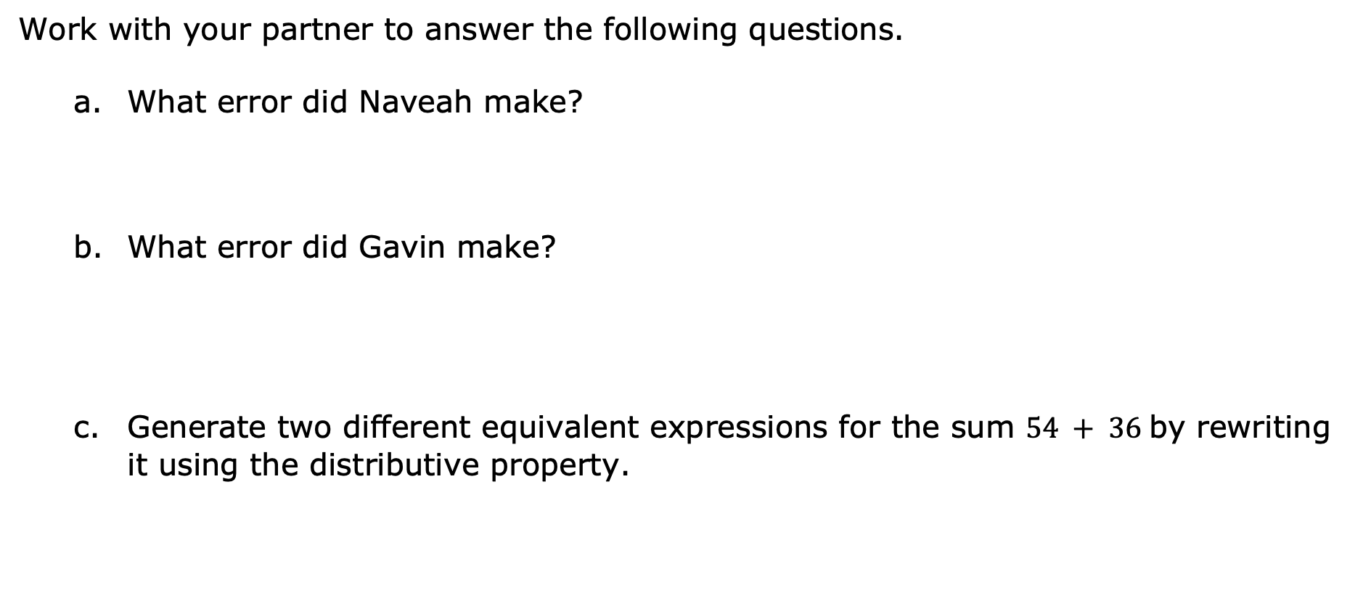
Work with your partner to answer the following questions.
What error did Naveah make?
What error did Gavin make?
Generate two different equivalent expressions for the sum $54 + 36$ by rewriting it using the distributive property.
volume 1, pg. 65

Slide 16
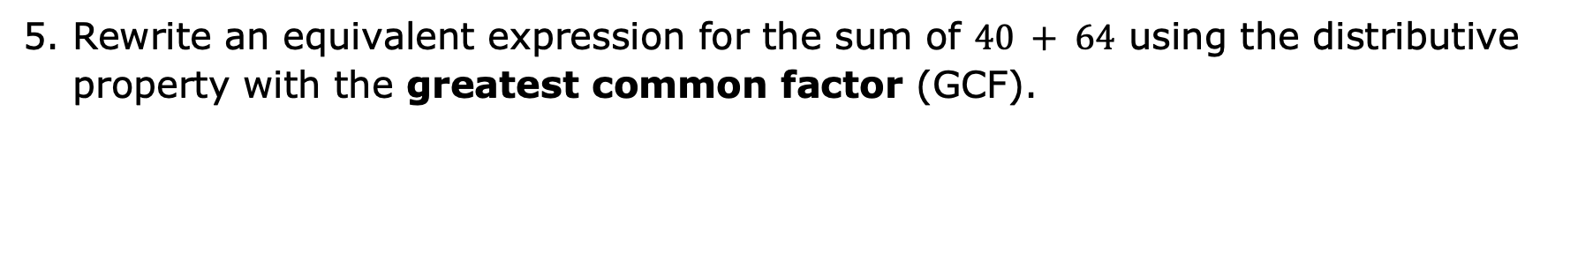
Rewrite an equivalent expression for the sum of $40 + 64$ using the distributive property with the greatest common factor (GCF).
volume 1, pg. 65

Slide 17
Collaboration
volume 1, pg. 66

Slide 18
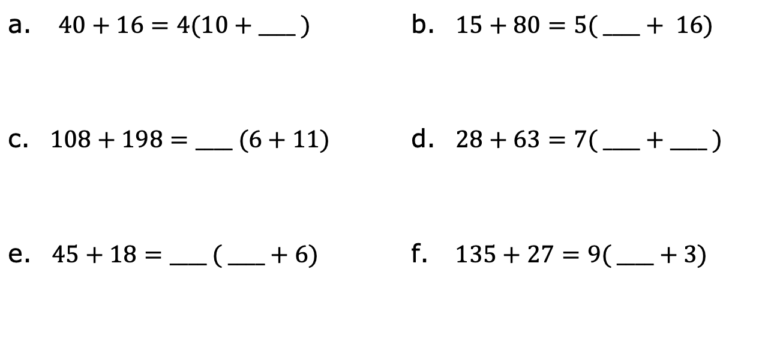
2.4.4 Collaboration: Missing Values
Work with your partner to determine the missing values that make each equation true.
a. $40+16=4(10+____ )$ | b. $15+80=5( ____+ 16)$
c. $108+198=____ (6+11)$ | d. $28+63=7( ____+____ )$
e. $45+18=____ ( ____+6)$ | f. $135+27=9( ____+3)$
volume 1, pg. 66

Slide 19
Choose one of the equations from the table and explain how you determined the missing value(s).
To find the missing value in equation _________, I ___________________________________________
___________________________________________.
Have your partner read your explanation and offer suggestions on how to improve it.
volume 1, pg. 66

Slide 20

Your Turn
volume 1, pg. 66

Slide 21
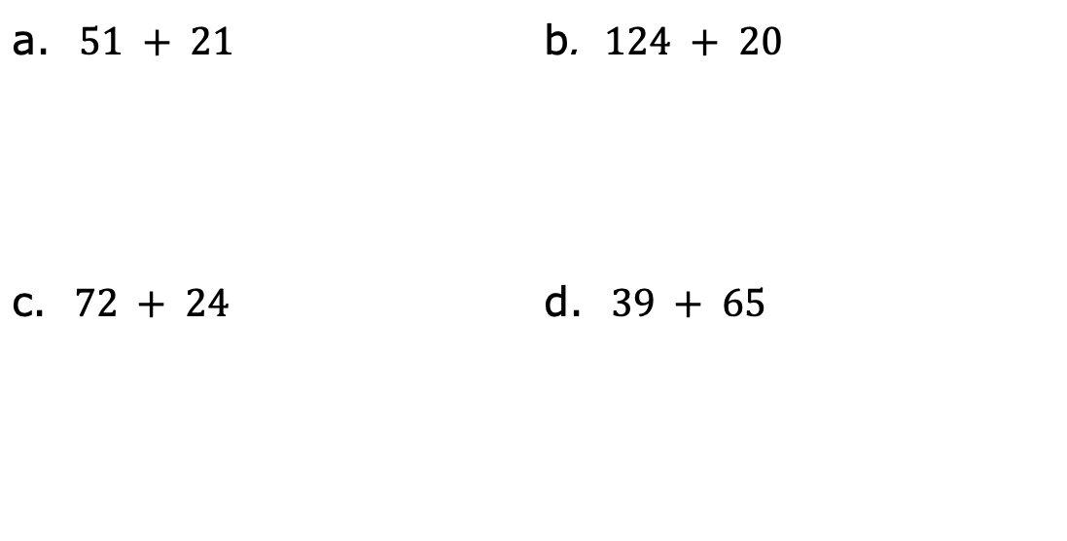
2.4.5 Your Turn!
Rewrite an equivalent expression for each sum using distributive property with a common factor.
a. $51 + 21$ | b. $124 + 20$
c. $72 + 24$ | d. $39 + 65$
volume 1, pg. 66

Slide 22
Rewrite an equivalent expression for the sum of $68 + 34$ using the distributive property with the greatest common factor (GCF).
volume 1, pg. 66

Slide 23

Wrap-Up
volume 1, pg. 67

Slide 24

2.4.6 Wrap-Up: Ticket Out the Door
Rewrite an equivalent expression for the sum of $75 + 30$ in two different ways using the distributive property and a common factor.
Complete the equation with the missing values that make the equation true.
$$49+35=____ (7+____ )$$
volume 1, pg. 67

